Slide 1
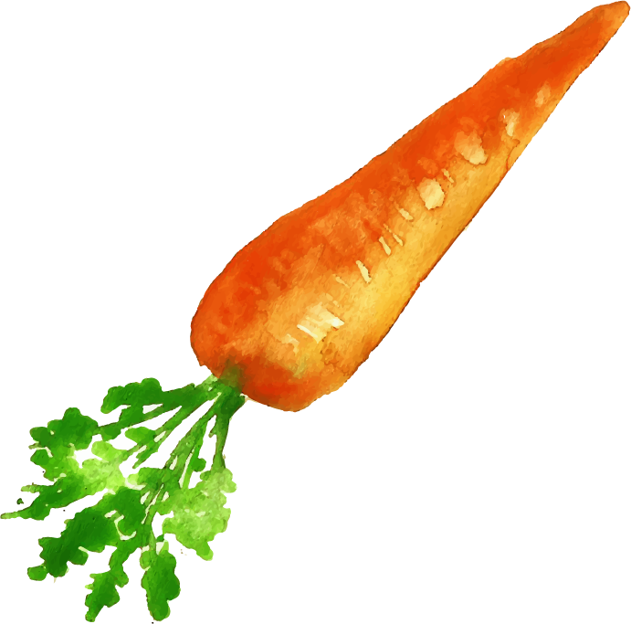







DSA3101
Assignment 2
Group 2
Ahmad As-Shodiqqul Amin (A0201627N)
Dione Lim Yee Sze (A0206307N)
Kellie Chin Shu Wen (A0205467A )
Keith Tay Xiang Rui (A0204695Y)
Lua Jun An (A0206136N)
Ni Hui Ling (A0204943H )
Timothy Wong Hoey Pheen (A0196615W)
Tu Zhehao (A0200130M )

Slide 2
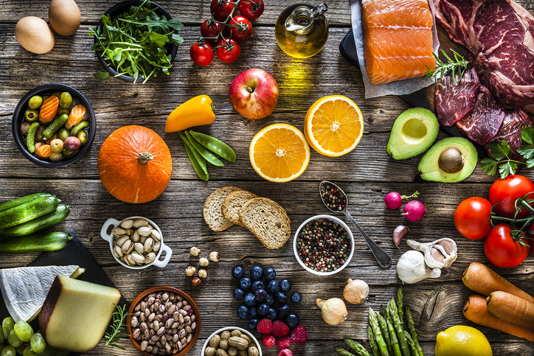
Aim :Promote Healthy Eating

Slide 3

Table of Contents
Objectives
Exploratory Data Analysis
Feature Engineering
Clustering
Final Media Plan
Evaluation and Future Works

Slide 4
Objectives
Notes:
The main objective of the Hackathon is to encourage the population to minimise their spending on packaged foods by maintaining an optimal level of calories consumption based on previous habits. In other words, it is to promote healthier purchasing and consumption habits.
Following this, our group’s objectives then are as follows:

Slide 5
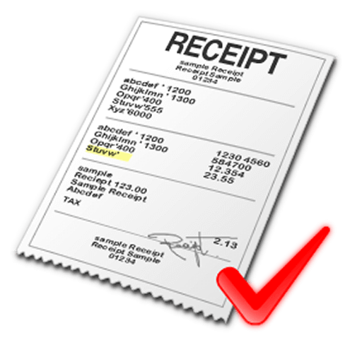





Objective 1: Segmentation
Important to understand and identify the different consumer segments using the data provided
Transaction history
Media usage
3. Demographics
Notes:
To identify different consumers segments based on their personal details and overall lifestyle like spending habits and media consumption

Slide 6
Objective 2: Selection
We also want to identify suitable media channels to maximize our campaign’s media outreach
When — Is there an optimal time?
Where — Media platform with the highest penetration?
Notes:
suitable media channels through which we can maximize our campaign’s media outreach

Slide 7
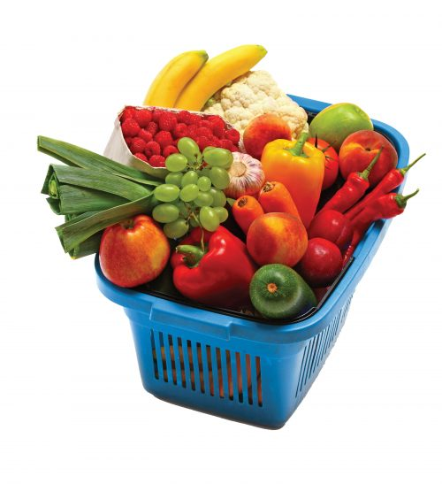
Objective 3: Incentivisation
We want to encourage and incentivise the different customer segments to
Try healthier alternatives
Maintain healthy eating habits
Notes:
To design an app which utilises a recommendation system for the different consumer segments to purchase healthier substitutes
To incentivise and encourage different consumer segments to continually purchase healthier substitutes
To break existing habits and promote newer, healthier habits across the different consumer segments

Slide 8
Exploratory Data Analysis

Slide 9
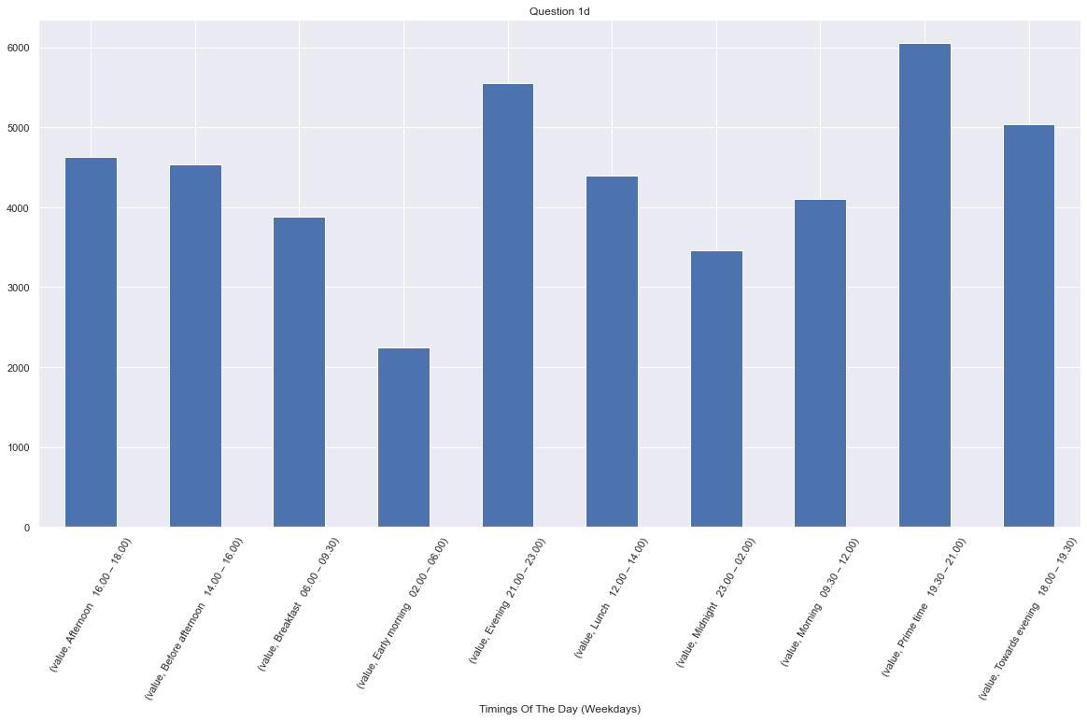
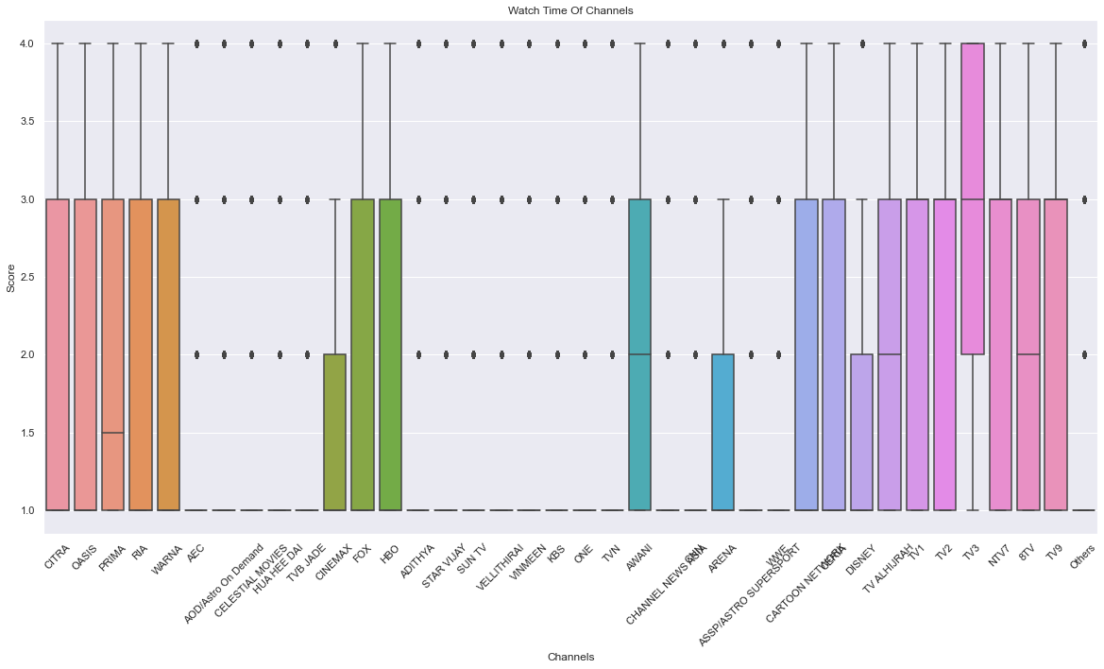
TV Consumption
19:30 - 21:00 & 21:00 - 23:00
Are prime timings
Local TV (TV3) most watched
Notes:
Based on the Figures, we notice that even on weekends, the majority of the panelists watches television during the ‘Prime Time’ and in the ‘Evening’.
I only leave the weekday one as weekends show a similar trend. The chart for weekends is at the next slide, if don`t need just delete the next slide.

Slide 10
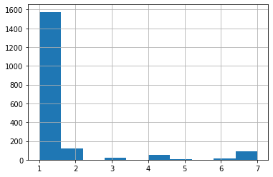
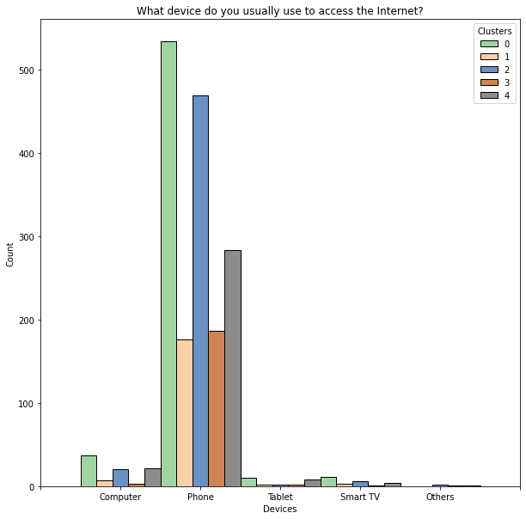
Internet Access
Most panelists use the internet daily
Phones main way of accessing internet

Slide 11
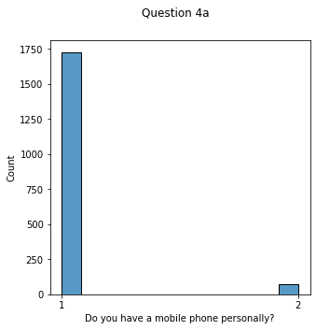
Phone Ownership
Most own a phone
Most have mobile data
Notes:
Most people have a mobile phone personally
Most people use a Smart phone
Most people have Internet Data
Older you are, less likely you have a phone
Lower income you are, less likely you have a phone or have a data plan

Slide 12

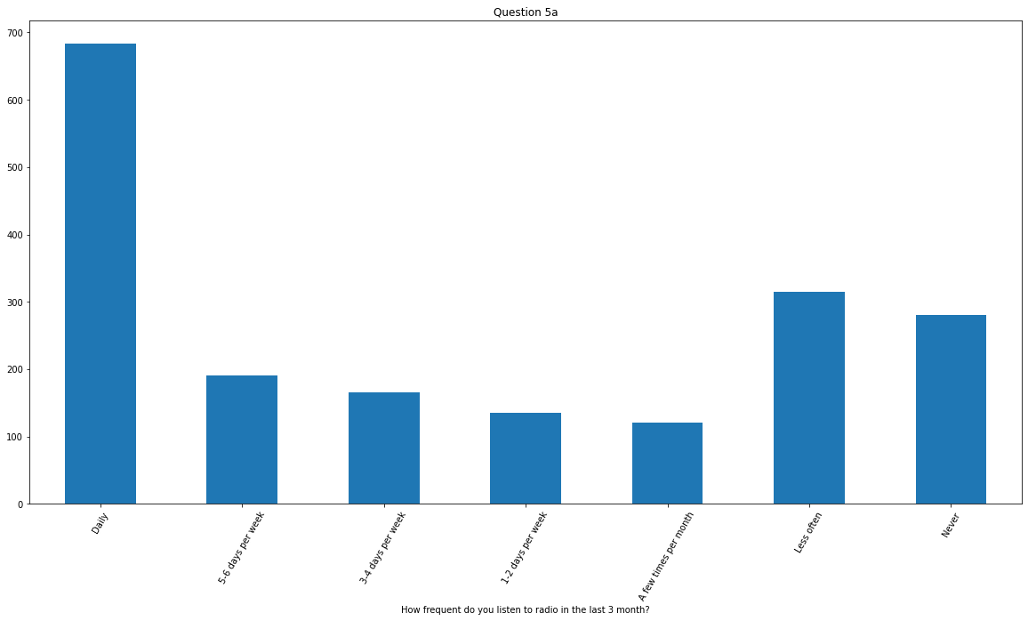
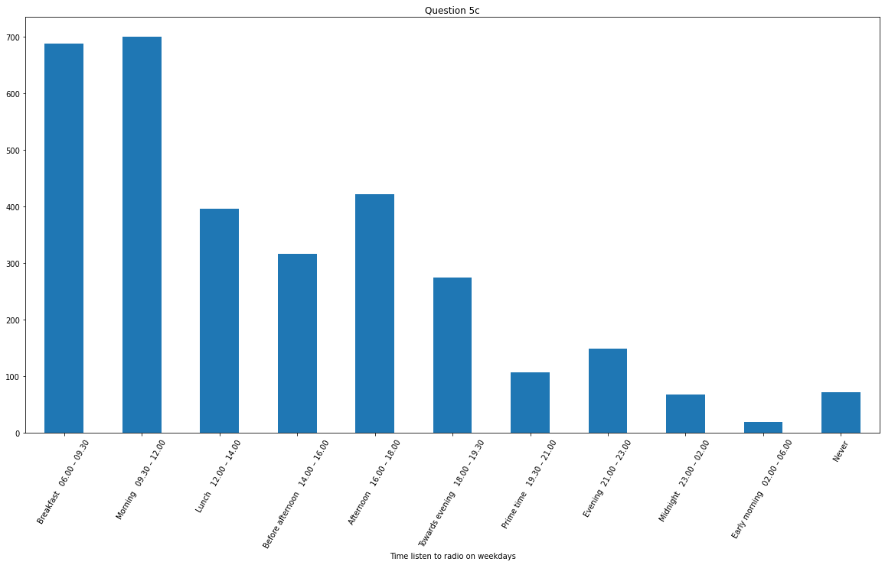
Radio Consumption
Morning to Noon (0630 - 1200)
is prime time
Most listen to radio daily
Notes:
Most panelists surveyed listen to radio daily.
Most of those surveyed also tend to listen to radio on weekday mornings

Slide 13

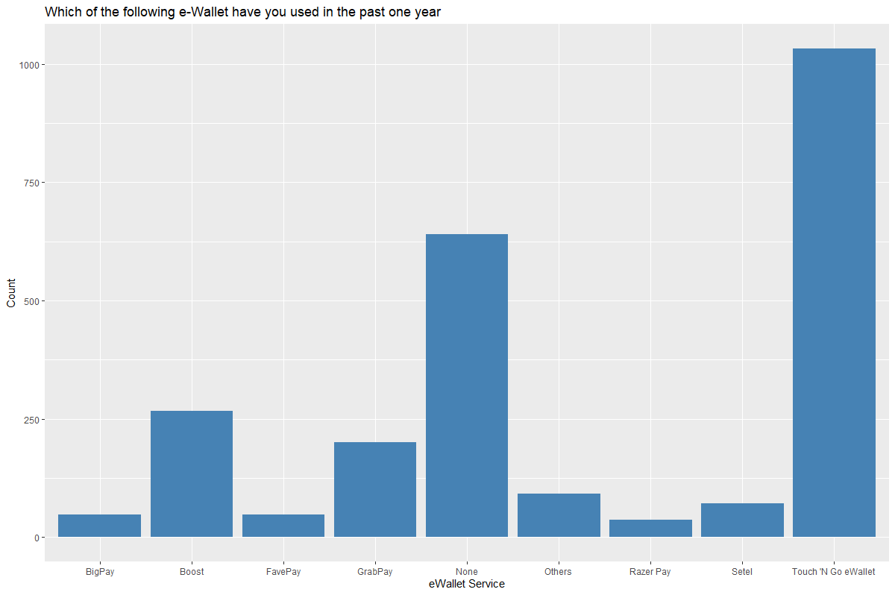
eWallet Usage
Majority of eWallet users uses Touch’N Go
Notes:
Touch N’Go E-wallet is the preference if the panelists surveyed wish to use an e-wallet.
Furthermore, the proportion of users who use the Touch N’ Go is highly collinear with the proportion of users who choose to use the eWallet.
After considering each question individually, we then look into the correlation of each question with each other, to garner a deeper insight.

Slide 14

Preliminary EDA Conclusion
To formulate an effective, wide-reaching media plan
Advertise on local TV and radio
Broadcast campaign messages at prime timings
Consider collaborations with Touch’N Go
Notes:
Touch N’Go E-wallet is the preference if the panelists surveyed wish to use an e-wallet.
Furthermore, the proportion of users who use the Touch N’ Go is highly collinear with the proportion of users who choose to use the eWallet.
After considering each question individually, we then look into the correlation of each question with each other, to garner a deeper insight.

Slide 15
Feature Engineering

Slide 16

Feature Engineering
From our initial findings, we discover:
Response rates are low for some questions
Many factors are more prominent than others
Format of the columns made it difficult to run analysis
Notes:
i placed feature engineering after EDA bcos it would make more sense, since feature engineering is derived from our initial EDA

Slide 17

List of Features
Key findings are extracted and preserved in our engineered columns
Q1
Frequency of TV consumption
Hours Watched of TV / week
Q4
Possession of mobile phone
Access to mobile data
Q7
Uses eWallet
Uses Touch’N Go
Q2
Frequency of Internet access
Availability of internet at home
Q5
Frequency of radio consumption
Weekday mornings radio listener
Q3
Frequency of Youtube watchtime
Q6
Frequency of reading newspapers
Content read in newspapers

Slide 18
Categorization of Goods
62 distinct food in the dataset
Food Types
Alcohol
Beverage
Cooking Essential
Carbohydrates
Dairy / Eggs
Snacks
Calories
High Calories (> 400 cal / 100g)
Low Calories (< 400 cal / 100g)
Notes:
6 Main Food Groups
In the DACC_Hackathon_Categories_Information_V2.csv dataset provided, there were 62 different food categories. To make the data more interpretable, we further grouped these 62 different categories of food into 6 main food groups - Alcohol, Beverages, Cooking Essentials, Carbohydrates, Dairy/ Eggs and Snacks.
High or Low Calorie
We labelled foods with more than 400 calories per 100g as high calorie foods and foods with less than or equal to 400 calories per 100g as low calorie foods.
Percentage of Spending on Each Type of Food
To better understand each panelist’s grocery shopping habits, we decided to look at their spending on different types of food. Firstly, for each panelist, we calculated the overall total amount spent, as well as the total amount they spent on each of the 6 main food groups as we defined earlier. We also calculated the total amount spent by each panelist on high calorie foods. Next, we divided their total amount spent on each of the 6 main food groups and high calorie foods by their overall total amount spent to get their percentage of spending on each type of food. This resulted in the DataFrame shown below (Fig. 4) where each row represents a unique panelist and each column represents the panelist’s percentage of spending on that type of food.

Slide 19
Clustering
Notes:
we have to reach clustering by 4min or else we’ll run out of time.

Slide 20
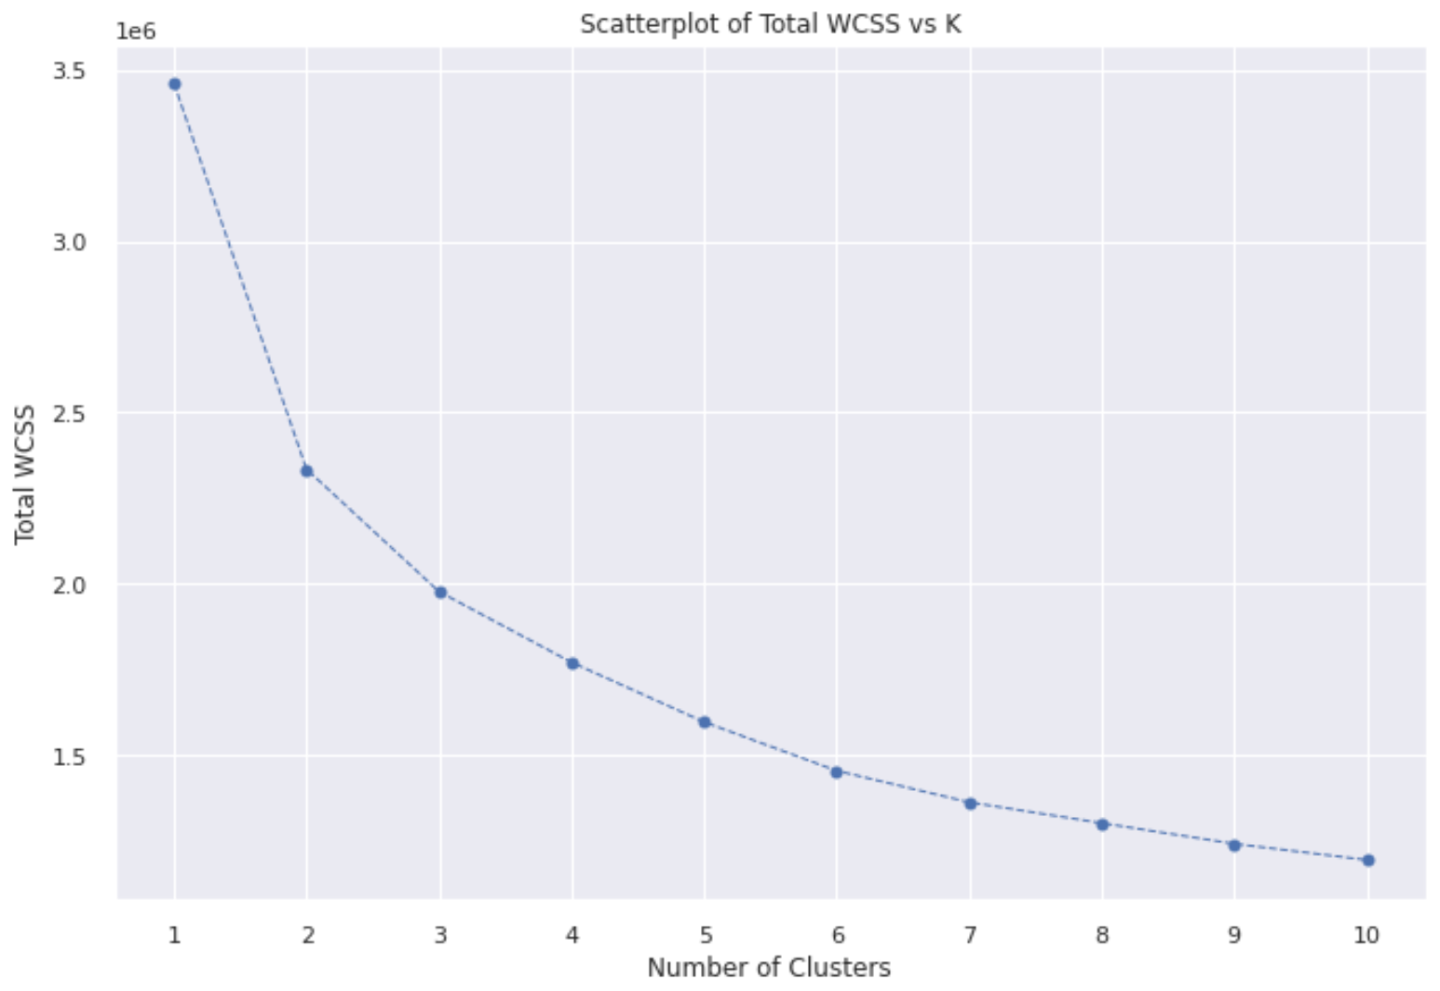
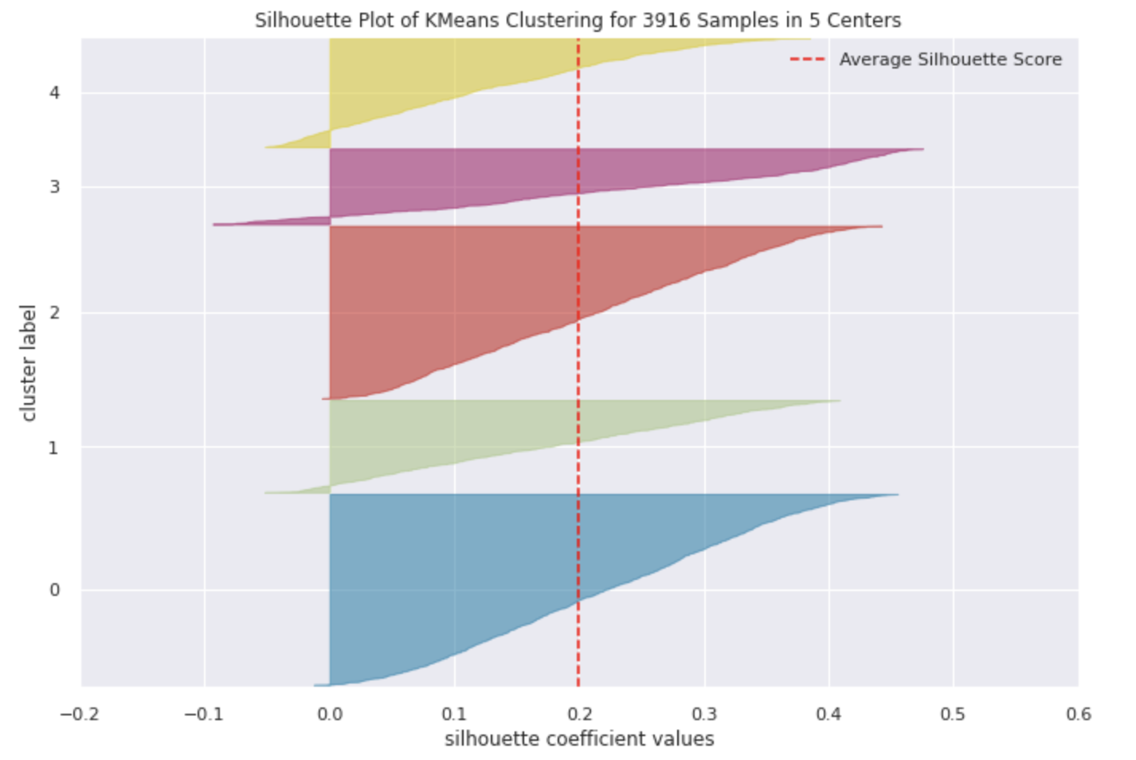
Clustering
K-means using 5 clusters

Slide 21
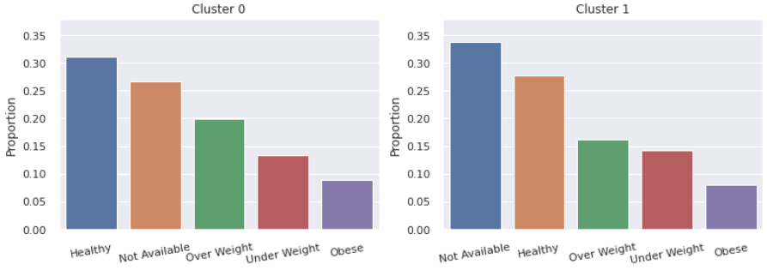
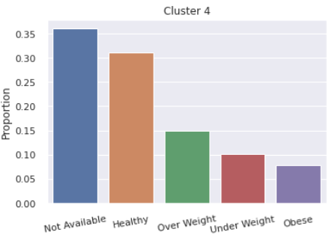
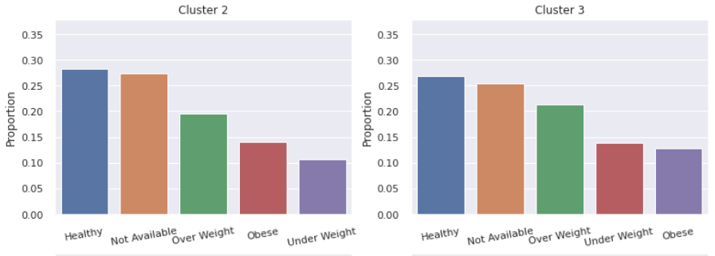
Clustering Analysis: BMI
Highest proportions of unhealthy individuals
Notes:
As shown above, Clusters 0 and 4 have the highest proportions of healthy individuals, forming about 30% of each cluster. In contrast, Clusters 2 and 3 seem to have high proportions of unhealthy individuals. Around 45% of Clusters 2 and 3 belong to the “Obese”, “Overweight”, or the “Underweight” categories.

Slide 22
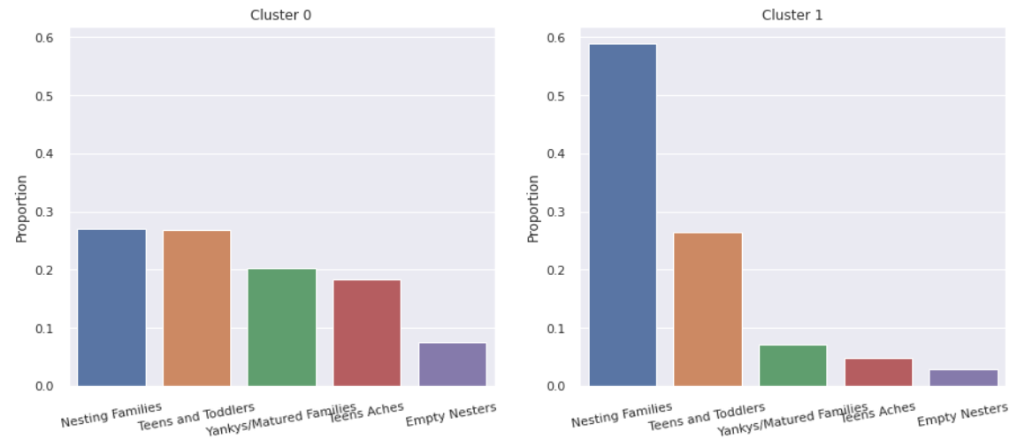
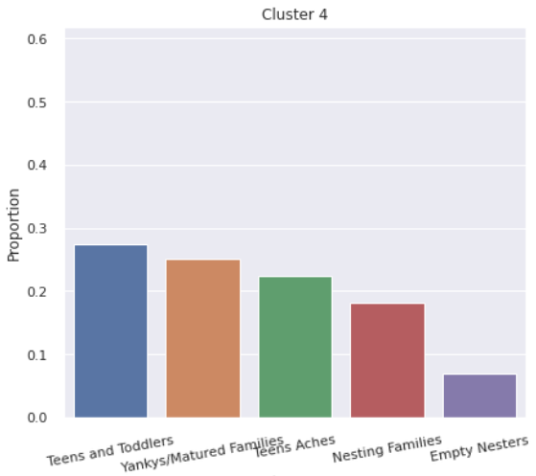
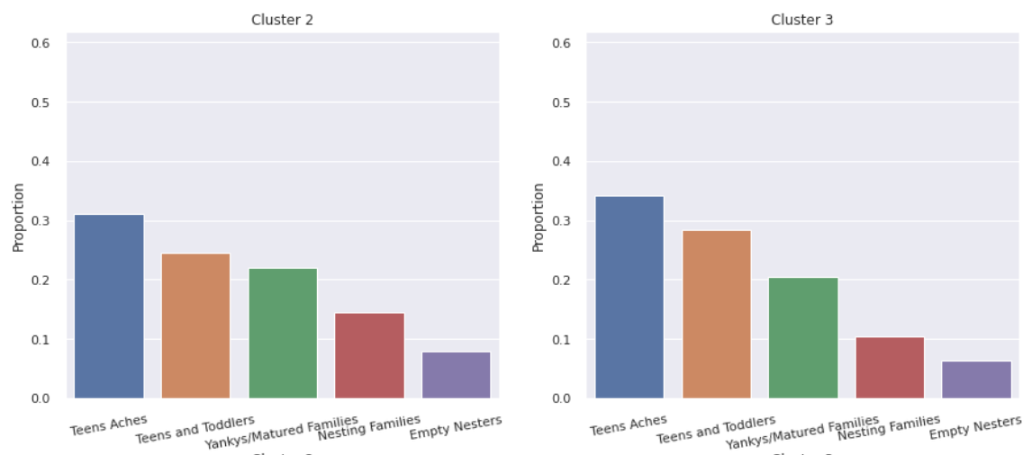
Clustering Analysis: Lifestage
Majority families with young kids
Notes:
Cluster 1 has an overwhelmingly large proportion of families with young kids as Nesting Families and Teens and Toddlers make up ~80% of the cluster.

Slide 23
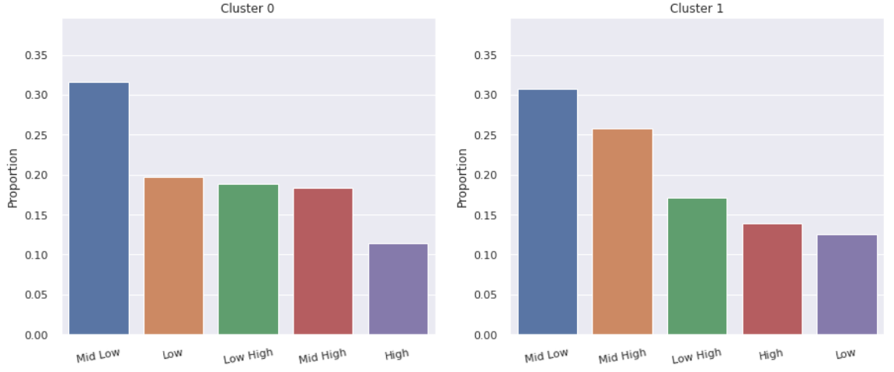
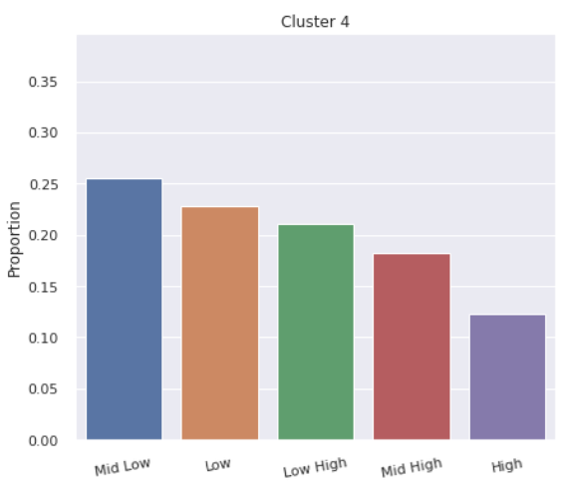
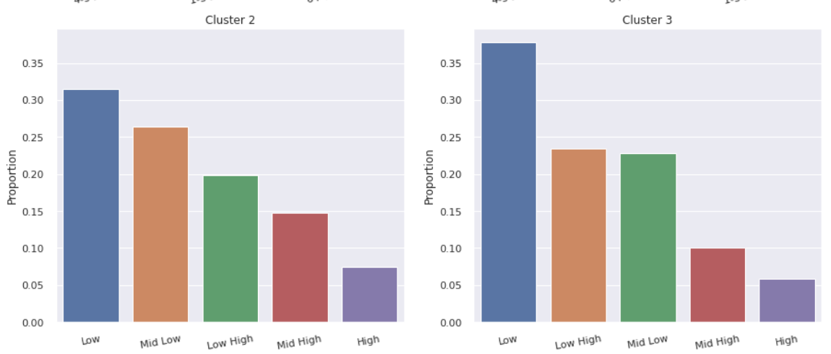
Clustering Analysis: Income
Cluster 0: Low-Mid
Cluster 1: Mid
Cluster 2: Low
Cluster 3: Low
Cluster 4: Mid
Notes:
For Cluster 0, the majority of the individuals are low to middle income earners, with 30% of the cluster earning between RM3000 and RM4999 (Mid Low) and 40% of the cluster earning below RM3000 (Low + Low High).
For Cluster 1, the majority of the individuals are middle income earners, with 55% of the cluster earning between RM3000 and RM7999 (Mid Low + Mid High). Additionally, Cluster 1 has the highest proportion of high income earners. About 13% of the cluster earns more than RM7999.
For Cluster 2, the majority of the individuals are low to middle income earners, with 50% of the cluster earning below RM3000 (Low + Low High). The high income earners only make up less than 10% of this cluster.
For Cluster 3, the majority of the individuals are low income earners, with 60% of the cluster earning below RM3000 (Low + Low High). Like Cluster 2, the high income earners only make up a very small proportion of this cluster (around 5%).
For Cluster 4, the majority of the individuals are middle-low income earners, with 45% of the cluster earning below RM4999 (Low + Mid Low). Similar to Cluster 1, Cluster 4 has a high proportion of high income earners too. About 12% of the cluster earns more than RM7999.

Slide 24
Cluster Characteristics
Cluster | Main Cluster Features | Cluster Name
0 | Domesticated baskets Most indicators are average | Average Consumer
1 | Low support for cooking goods Mostly consist of nesting families | Families with young children who seldom cook
2 | Highest relative support for cooking goods High proportion of young people | People that cook often
3 | High proportion of young people Highest support for food with high carb (rice, eggs) | Young people with high carb diets
4 | Highest relative support for snacks Higher proportion of high income earners | Working People who seldom cook and snack a lot
Notes:
Finally, with all the analysis, we now understand each cluster better and can assign characteristics that identifies these clusters.
Cluster 0: The top 10 itemsets indicate that this group usually have more domesticated baskets and since most indicators are average, this group is most probably an average person.
Cluster 1: From the lifestage breakdown in 5.5, we see that an overwhelming majority of this cluster belong to Nesting Families, these are probably families with many kids, which explains their high support for milk powder - kids and liquid milk. This group probably does not cook as often as the other clusters judging from the low supports for cooking essentials, which is even lower than Cluster 4.
Cluster 2: From the income breakdown in 5.7, this group consists of mainly low to middle income earners and from the high supports of egg, sugar, cooking oils and cooking sauces, this group probably cooks often and eats a lot.
Cluster 3: This group is similar to Cluster 2 except people in this group have generally lower income. In addition, this group has high support for rice and instant noodles. The itemsets (rice, eggs) and (sugar, rice) are also within the top 10 highest support itemsets for this group. Hence, this group likely consists of people with high carbohydrate diets.
Cluster 4: From the BMI breakdown in 5.1, this group has the highest proportion of healthy people, and the lowest proportion of underweight (only 10%). This might be due to the snacking as shown in the high supports for biscuits and snacks. From the income breakdown in 5.7, we see that this group has a higher proportion of higher income individuals, which might be a reason why they can afford to eat out and eat healthy
The higher income indicates the probability that this group consists of many white-collared office workers. Hence, this group is probably working individuals who seldom cook.

Slide 25
Recommendation System

Slide 26
Recommendation: Sihat App-ah!
For a more holistic approach, we take into account the following
Calories
Other health benefits
Notes:
Before going into the how, we need to gather the ingredients first. We decided to take calories and other health benefits into account. The main reason is because we feel that calories alone is not accurate in deciding whether a given item is healthy or not.

Slide 27

Defining Healthy
Healthier Choice uses 6 methods of comparison against a benchmark
Higher in Whole grains
Higher in Calcium
Lower in Sodium
Lower in Saturated fats
Lower in Sugar
Trans-fat free
Notes:
So, we decided to use health promotion board’s definition of a healthier choice. According to them, a healthier choice is one with higher whole grains, higher calcium, lower sodium, lower saturated fats, lower sugar and is trans-fat free. With that, we are ready to move on to how our recommendation system works.

Slide 28

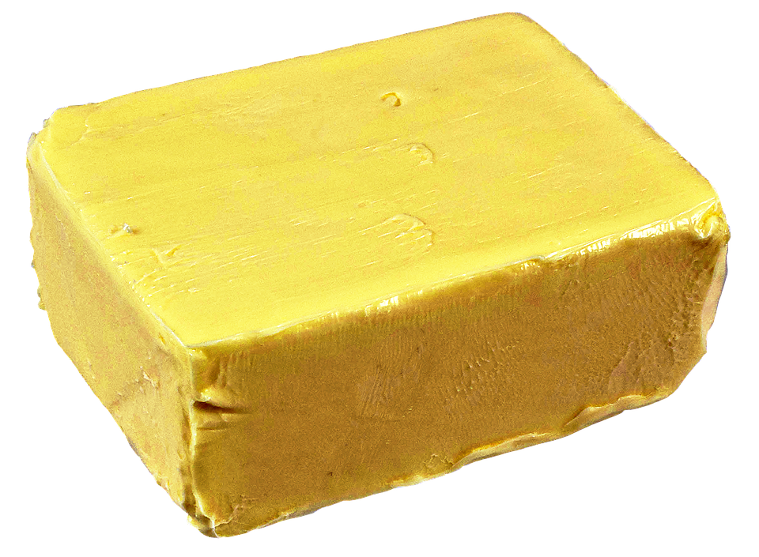

Architecture
Yes
Recommend a healthier substitute
Check if a given food has healthier options
Inputs:
Item Name
6 Variants
Calories
Category
NLP (BERT)
Retrieve Similar Items
Remove it from the list of recommendations
No
Notes:
As mentioned earlier, we categorised the items into 6 broader categories namely Carbohydrates, Alcohol, Dairy/Eggs, Beverages, Cooking Essentials and Snacks. However, this poses a problem to us. For example, eggs (click) and butter (click) are in the same category. But would we substitute eggs for butter? The answer is no! (click) So, to bridge this gap, we decided to add another layer of filtering using NLP. By using that, we hope to be able to find items that are semantically similar within each of these broad categories. By doing so, we also hope to provide more reasonable recommendations with this added layer of filter. So how exactly do we do this? Let me show you an example.

Slide 29
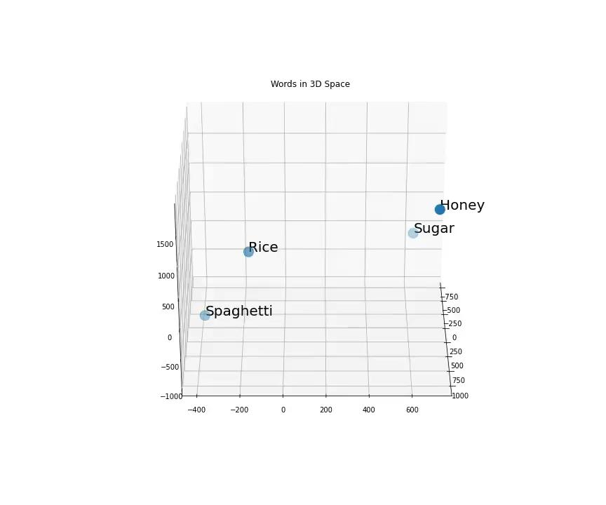
Word Embeddings In 3D
Notes:
Using NLP, we are able to convert each item name to a word vector and express them in a 2D/3D plane. So from this video, we can see that Sugar and Honey closer in the 3D space as compared to the Spaghetti-Rice pair. So using a distance metric like cosine similarity or euclidean distance, we can decide which items are closer to each other. With this video, I hope it presents to you a clearer idea of what we are trying to do.

Slide 30

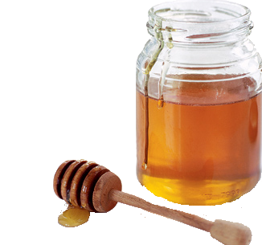

Checking For Healthier Options
Item: Honey
Wholegrains: 0g
Calcium: 0mg
Sugar: 0.5g
Sodium: 0mg
Saturated Fats: 0g
Trans-fats: No
Calories/100g: 304g
Item: Sugar
Wholegrains: 0g
Calcium: 0mg
Sugar: 10g
Sodium: 0.01mg
Saturated Fats: 0g
Trans-fats: No
Calories/100g: 405g
Notes:
After which, we start checking for the healthier option. For example, we have two items, sugar and honey. Both of them are sweeteners. We have the 6 nutritional values as well as the calories that we mentioned earlier. By penalising and rewarding nutritional aspects accordingly, we are able to tell which item is a healthier substitute.

Slide 31
Recommendation Summary Table
Original Item | Recommended Item
Cake | Chocolate
Soy Milk | Plant Based Milk
Creamer | Liquid Milk
Yoghurt Drink | Yoghurts
Instant Coffee | Coffee
Snack | Biscuits
Tonic Food Drink (Assume Milo) | Tea
Wine | Spirits
Sugar | Honey
Notes:
So after running the entire dataset, here are some of the recommendations that our system has provided us with and we can see that the recommendations are pretty reasonable. We have things like Snack to Biscuits and Instant Coffee to Coffee.

Slide 32
Media Plan

Slide 33
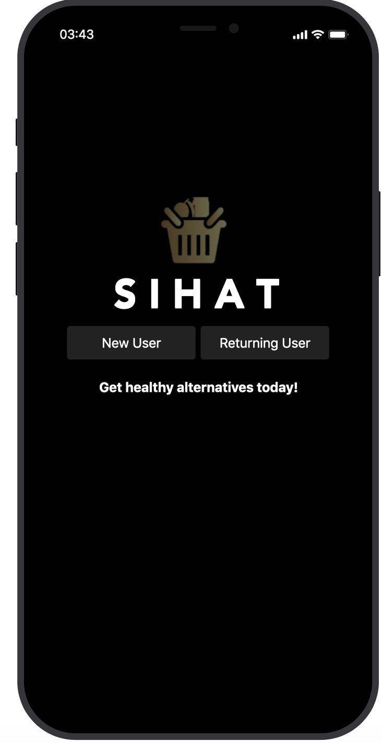
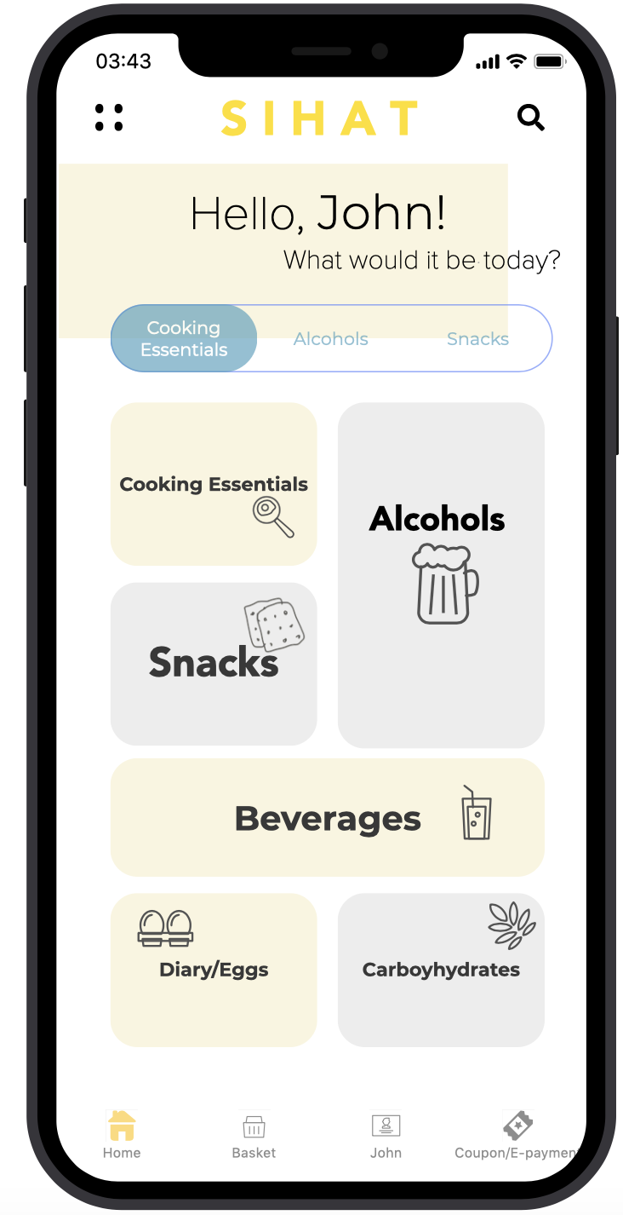
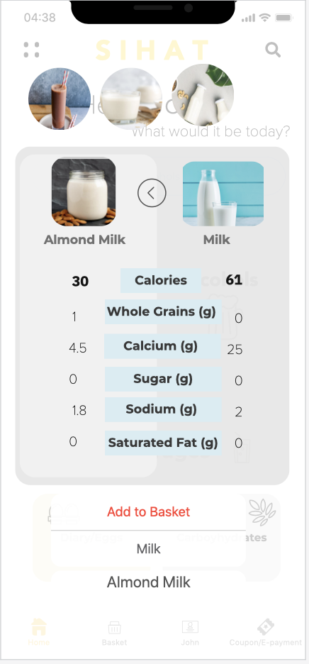
Sihat App-ah!: Recommendations
Login
Homepage
Recommendations
Notes:
So this is the interface of our app, the user will login and he would be greeted by the homepage. As he chooses the items that he wants to purchase, the app will also recommend healthier options on-the-go as seen from the 3rd image. Now the question is, how do we come up with these?

Slide 34
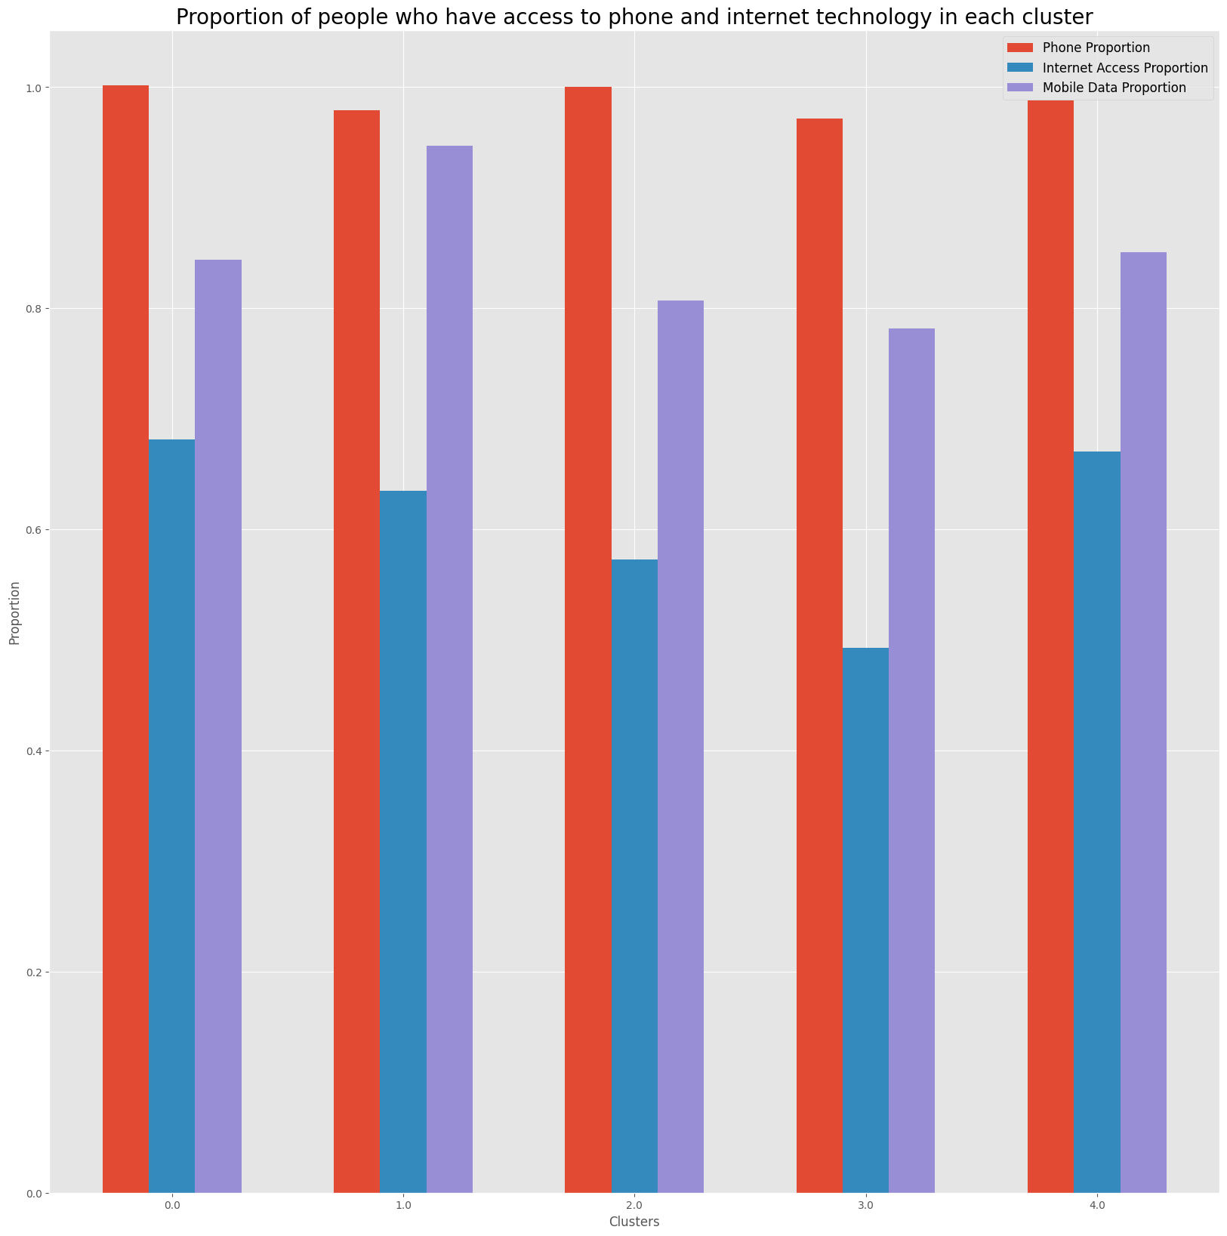
Why will this work?
Phone possession high across all clusters (as with Preliminary EDA)
Some do not have internet at home and mobile data
→ OFFLINE

Slide 35
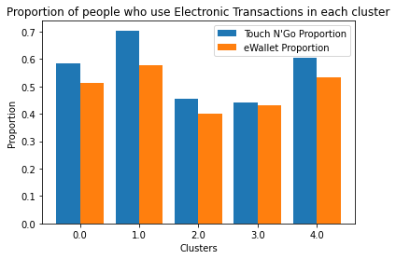
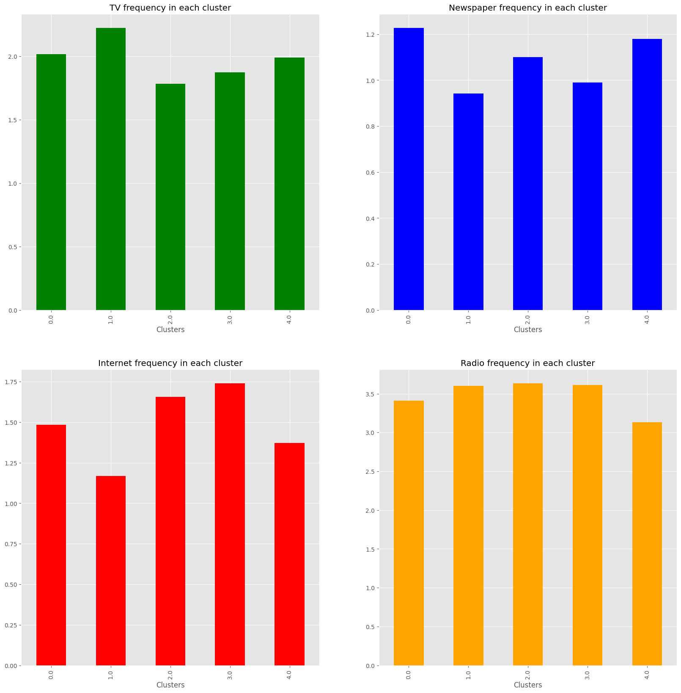
Breaking unhealthy habits
Recommendations for healthier choice
Translated into long-term lifestyle changes
?
Clusters
+ Coupons
2
3
Clusters
Low Income
Some do not have internet access
Some do not use e-payments
0
1
4
High Income
High internet usage
High usage of e-payments
E-payment and Loyalty Points

Slide 36
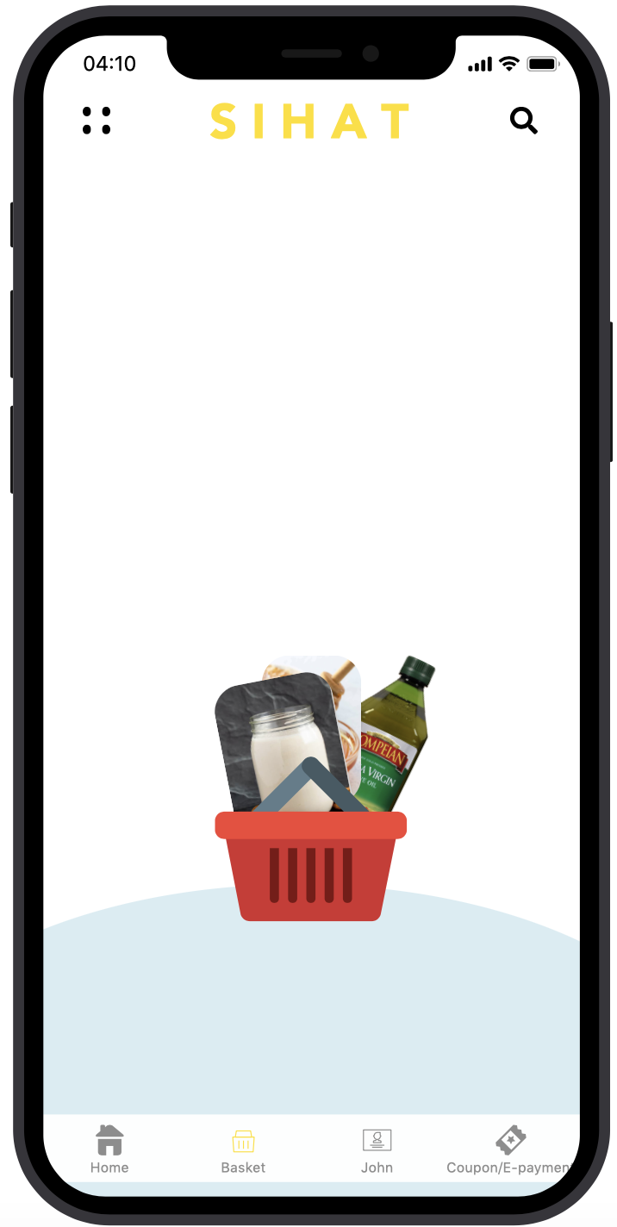
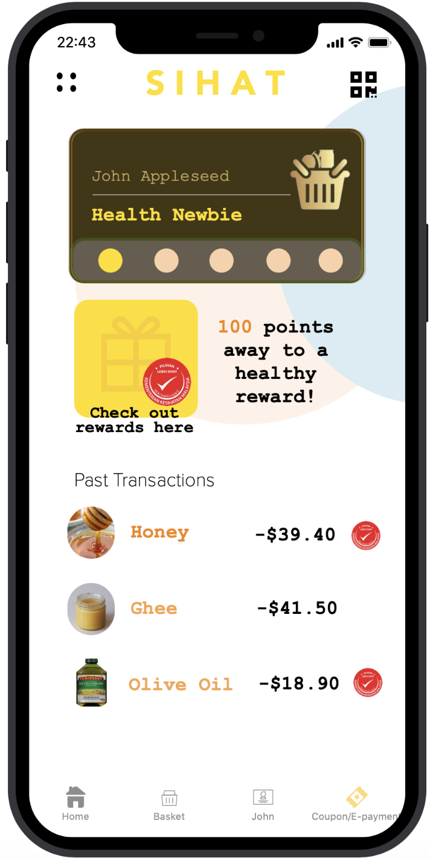

Sihat App-ah!: Redeem Freebies!
Login
Homepage
Recommendations
Checkout
Redeem Freebies With Loyalty Points!

Slide 37

Incentivization: Sihat App-ah!
Recommendations
Touch’N’Go
Loyalty Point System
Delivery
Sihat means Healthy in Malay!
Functions
Notes:
For the first part, let me introduce you our Sihat App-ah application that we came up with. So this application has our recommendation system included as well as the popular e-payment services like Touch’n’Go and eWallet. The beauty of this application is that it allows you to pay with it so it is like a paylah equivalent in local context and also, it has a loyalty point system which allows a user to redeem free healthier options after accumulating enough points. Given the current pandemic situation, I am sure many of us are afraid to leave our houses. Don’t worry, with SIHAT APP-AH we allow you to order your groceries whenever and wherever you are. On-the-go recommendations will also be provided as you pick the items that you wish to buy. With all these features, we hope that users would be influenced by our recommendations and make a more informed decision when choosing their groceries!

Slide 38
Breaking unhealthy habits
Recommendations for healthier choice
Translated into long-term lifestyle changes
?
Clusters
+ Coupons
2
3
Clusters
Low Income
Some do not have internet access
Some do not use e-payments
0
1
4
High Income
High internet usage
High usage of e-payments
E-payment and Loyalty Points

Slide 39
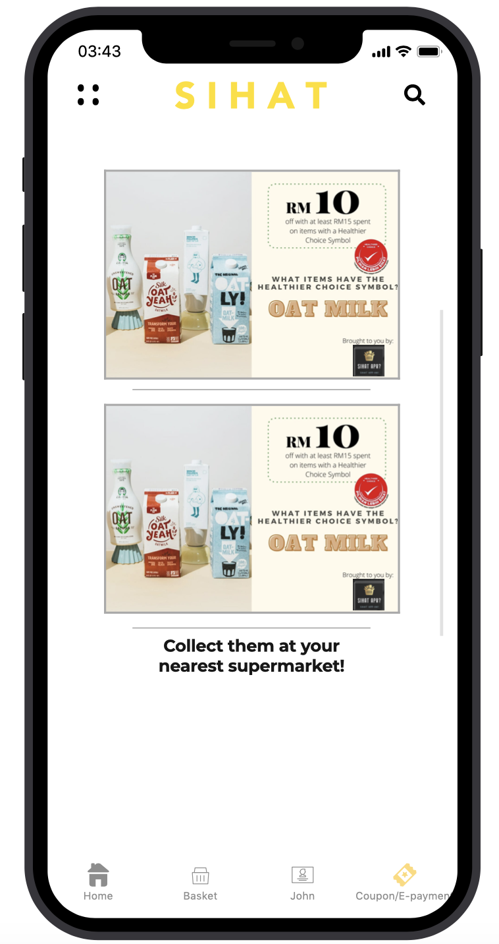
Sihat App-ah!: Coupons
Login
Homepage
Recommendations
Checkout
Redeem Freebies With Loyalty Points!
Apply Coupon

Slide 40
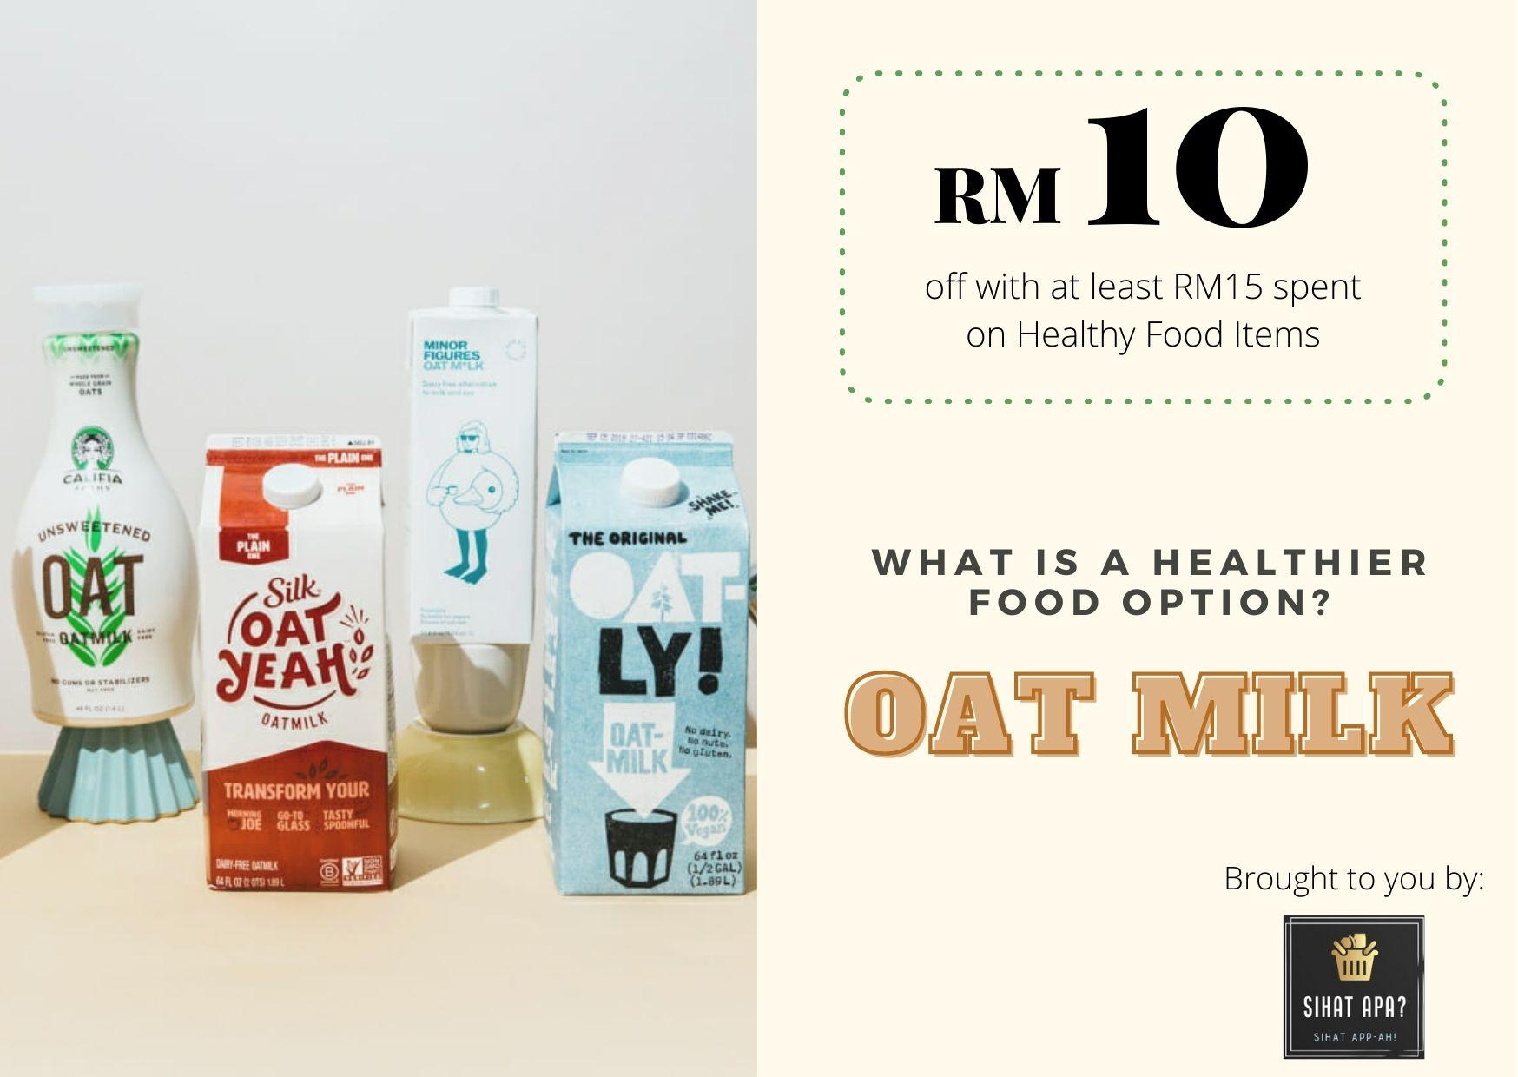
Incentivization: Coupons
To ensure our campaign is complete and inclusive of everyone
Only accessible to lower income bracket
Discounts on healthy foods which tend to be pricier
Igniting a change to a HEALTHIER CHOICE
Collection using ID at CCs

Slide 41
Maximising Media Exposure
We will disseminate details of our campaign through 2 main mediums
Radio
TV
Prime Time:
Evenings
Prime Time:
Mornings
Full
Media
Coverage
TV1 and TV3
(Most watched)
3 stations for 3
Ethnicities:
THR Raaga, ERA,
MyFM
App + Coupons (Clusters )
Our App
2
3
Note: 1 is the most frequent and 7 is the least frequent

Slide 42
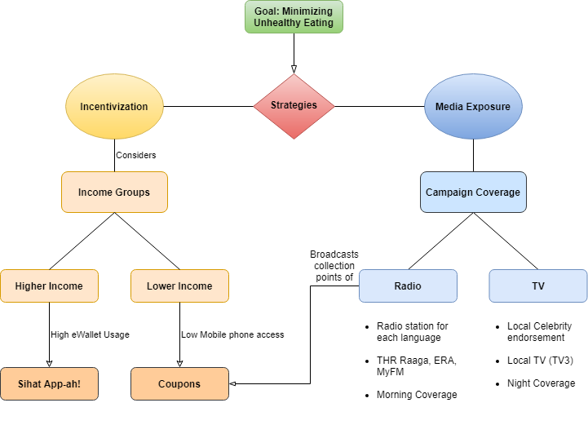
Dual Approach
Recommendation and Incentivization
Maximising media exposure
Notes:
We know that healthier options are generally more expensive, so we decided to create an incentive for those that buy our recommended healthier options. This can be done through our recommendation-cum-epayment app and a coupon system for those with no access to mobile data. At the same time, we aim to maximise our media exposure in order to reach out to a greater proportion of our target audience. This is also why we plan to advertise this strategy through radio and TV broadcast as these were the main platforms of media used based on the analysis earlier. (click)

Slide 43
Evaluation

Slide 44
Evaluation: Recommender System
Macronutrients | Percentage Change
Wholegrains (Fibre) Per Serving | 4.76464
Calcium Per Serving (Scaled by 10) | -47.3271
Sugar Per Serving (Scaled by 10) | -32.3425
Sodium Per Serving (Scaled by 100) | 0.326619
Saturated Fats Per Serving (g) | -64.2958
By following the recommended food items:
Reduced Sugar and Saturated Fats intake
This will benefit ‘Unhealthy’ Individuals from Clusters 2 and 3.

Slide 45
Evaluation: Media Plan
To increase adoption of the app and use of coupon:
Conduct period of discount for nutritionally healthier goods
This will generate hype and encourage consumers to adopt our strategy.
Current Plan
Sihat App
Coupon

Slide 46
Future Works

Slide 47
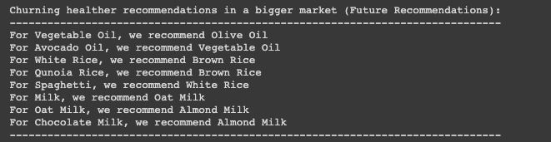
Future Works:
Scalability of Recommender System
Currently
Only 62 unique items in dataset
Not accurate representation of real world
Scalable Recommender System
Having more items will increase the number of direct substitutes
More diverse recommendations to users
Will make more sensible and accurate recommendations.
Realistically
1,000 to 10,000 unique items in marts

Slide 48



Thank You
Q&A

